Slide 1


SAP UI5 & FIORI with OData TRAINING
Anubhav Oberoy
Day – 29

Slide 2

Agenda – Day 29
Custom Controls in SAP UI5
Key user extensibility
SAP UI5 Best practices
Easy UI5 template
Troubleshooting Fiori Apps – Custom Apps

Slide 3
SAP UI5 does not become bottleneck for developers.
I want to design a heading control which display a heading on screen.
Ui5 Libs
Application
Renderer
HTML+CSS

Slide 4
Initialize
Development Tools
Project structure
File/folder names
Service usage
Code
Fragmentation
Nami-convension
Modules definition
JS Code
CSS Code
ESLint Checks
Stability
Stable Ids
Labels and tooltips
Internationalization
Visual appeal
Git commits
Product Standards
Performance
Asynchronous loading
Pagination
Server side preparation for analytics
Advance performance

Slide 5
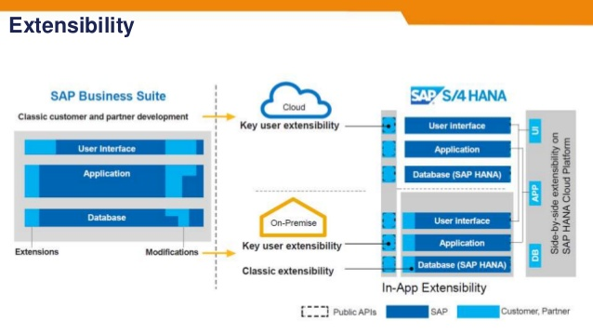

Slide 6
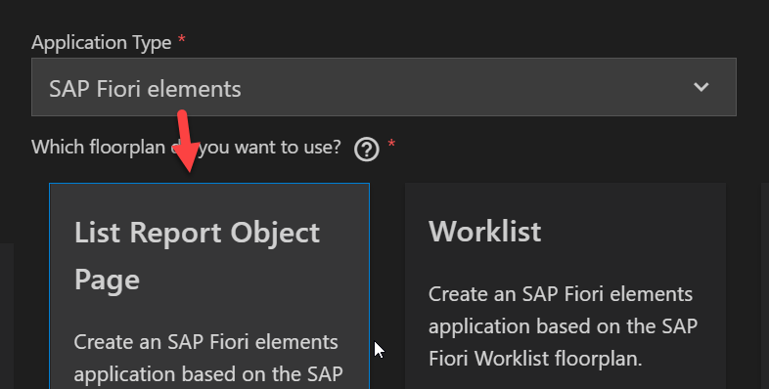
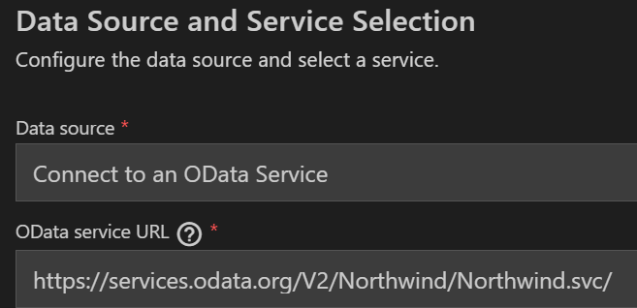
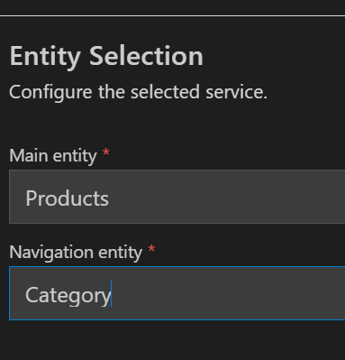

Slide 9

End of Day 29

Slide 10

Questions

Slide 11

Anubhav Oberoy

Slide 12


We’re committed to empower you to be
Most Desirable Resource
through powerful training solutions.
We build the workforce of the future.
290+
Corporate Clients
30,000+
Learners Trained
29000+
Learners Placed
FREE WEBINARS
Sign up for free webinars with industry experts every fortnight!
Enroll Now!
Contact us today!
https://anubhavtrainings.com/

Slide 13




More from AnubhavTrainings.com

Slide 14
Title
Content

